Slide 1
Teach Me
How to get smart

Slide 2
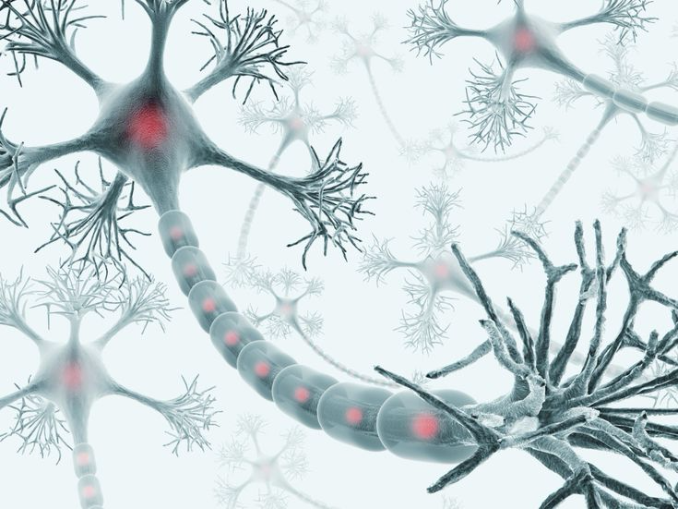

Slide 3
A Biological Neuron
That image looks like a lot of disconnected Neurons
Neurons send electric impulses to 1 – 1000’s of neurons
And receive from an external to 1000’s of other neurons
These create complex networks that can learn
But these learning networks are very hard to simulate

Slide 4
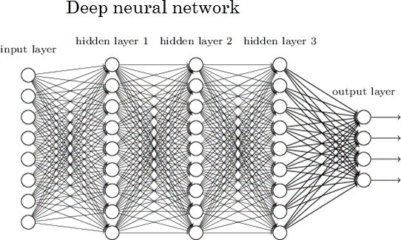

Slide 5
Common
Problem solving
Learns to solve through trial and error
Neurons
To pass along/receive information

Slide 6
Artificial Neural Networks
These try to imitate Biological Neural Networks (too structured)
Layers of neurons are mathed one layer at a time
The complexity is significantly reduced
A column of neurons fire through weighted paths (Matrix multiplication)
A small one can be trained for a specific task
Larger Networks may be able to do several tasks

Slide 8
About the Art
Forward Propagation – Sending information to some to be passed on to more
Back Propagation – Reviewing the information in reverse to try and correct it

Slide 9
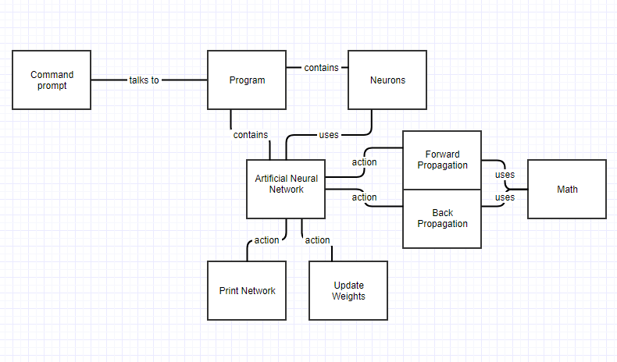

Slide 10
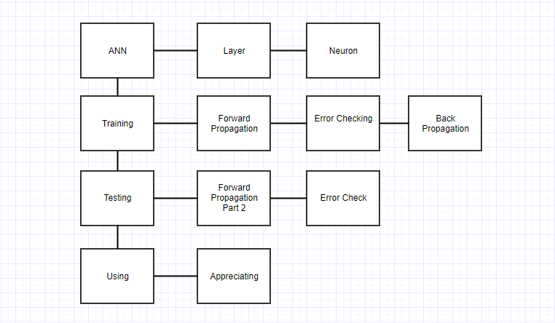

Slide 11
What’s different
A collection of Artificial Neural Networks
A standard Network structure and a couple structures of my own design
Simple to use
Once you’ve got good training sets
All done in C++ w/o other library downloads
Make it easy for people that (don’t) know how to use libraries

Slide 12
Link to More
https://github.com/Cosy-harks/Art_Neur_Net/tree/master/DevDocs

